Slide 1



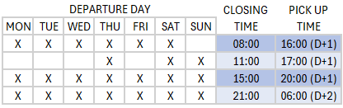
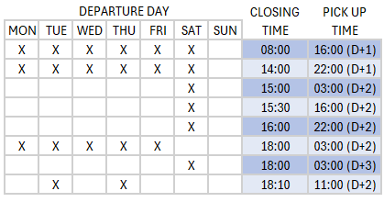

AF 02
TIMETABLE
LE BOULOU < > BETTEMBOURG
CONTAINERS
BETTEMBOURG > LE BOULOU
LE BOULOU > BETTEMBOURG
1
1
BETTEMBOURG Terminal intermodal, Eurohub Sud Z.A.E. Wolser E, 100
LE BOULOU Container Terminal Ambrogio Le camp de la Basse Le Boulou (66160-F) GPS: Lat.: 42,5238 - Long.: 2,8144
Dudelange (3437-L) GPS: Lat.: 49,4983 - Long.: 6,099
Opening time : 24/7
Opening time : Monday: 7:00 to 22:00, Tuesday to Friday: 6:00 to 22:00, Saturday: 8:00 to 18:00
Customer service : containers@viia.com Phone number containers : +352 24 87 68 31
For any question, please contact the trade lane Manager Audroné Bernotaité
+352 691 340 692

